Slide 1




TEAM VOTEX
Steel City Hacks, India

Slide 2

CONTENTS
TOPIC
TOPIC
TOPIC
TOPIC
01
02
03
05
X`
X`
X`
X`
OUR PROJECT
FEATURES
SUSTAINABILITY
TEAM
A Short Description of Our Project
Why our Project is Unique and Important?
How Our Projects relates to Sustainability?
Our amazing Team Members!

Slide 3

TEAM VORTEX
THEME
TEAM
PROJECT
BENEFITS

Slide 4
Project Pool-in
Project Pool-in is a website that allows users to get help, or help others to travel.
DID YOU KNOW?
BENEFITS
TEAM
THEME
PROJECT
An estimated 74,0001 premature deaths were attributable to transportation emissions in India 2015. This represents a 28% increase in annual transportation-attributable deaths in India compared with 2010. And these are increasing since then!
In 2018, India had 467,044 reported road accidents, an increase of 0.5% from 464,910 in 2017, according to the road ministry's data. India has 1% of the world's vehicles but accounts for 6% of the world's road traffic accidents, according to data from a 2018 World Health Organization report.

Slide 5
Sustainability?
First let’s consider what is sustainable Development?:
It is the economic development that is conducted without depletion of natural resources.
HOW OUR PROJECT RELATES TO SUSTAINABILITY?
BENEFITS
TEAM
PROJECT
THEME
Petroleum is a natural resource that is being depleted very quickly. Our project will help in environmental sustainability by reducing the use of fuel!
Our project can reduce noise and air pollution by reducing the traffic, which contributes to environmental sustainability!
Our project prevents congestion and reduces the chances of accidents, saving lives, and increasing government revenue(by the future spending of the individual), which contributes to economical sustainability!
Therefore, Our project contributes towards sustainable development, mainly environmentally!

Slide 6
Features of POOL-IN
PRIVACY PROTECTION:
We respect privacy of our visitors and therefore we use the following ways to protect their privacy:
We use Hashed Passwords, which mean that the password that is linked to the account is encrypted, which also prevents issues like hacking.
We have also enabled a email verification when a user registers to make sure that the user has entered a valid and their own email address.
We use cookies to keep out data safe and also to provide a personalized service for all of our users
TEAM
THEME
PROJECT
FEATURES

Slide 7
Features of POOL-IN
USER-FRIENDLY:
We have made our website so that the user can easily navigate through:
An interactive web design
Autocomplete feature allows users to select location, instead of typing which makes data entry more accurate!
THEME
PROJECT
TEAM
FEATURES

Slide 8
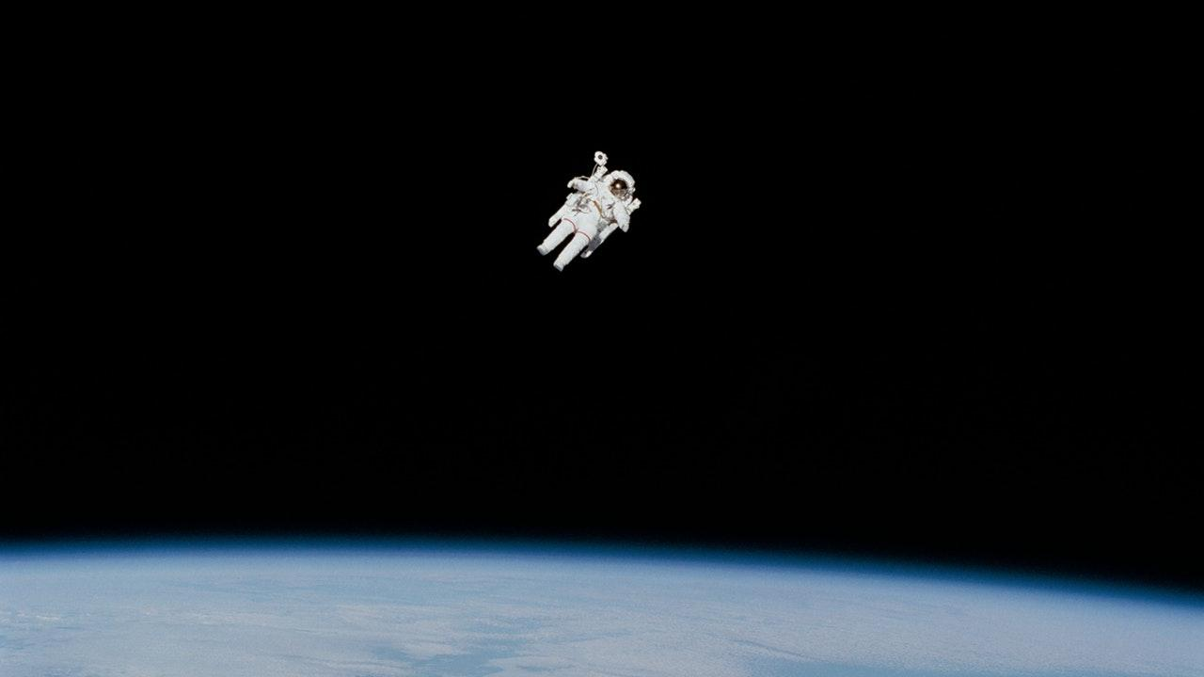
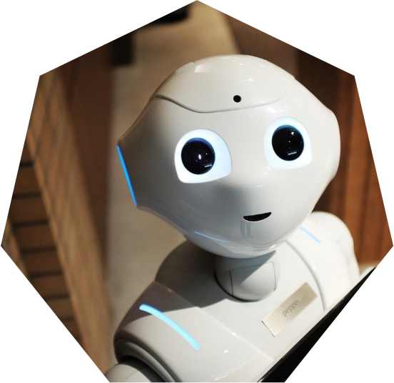
PROGRAMMING OUR WEBSITE
Our main aim is to build a full responsive website with functionality as much as possible.
We have used html and css to build our frontend .
Through html codes we created the backbone of our webpage and with the use of css we were able to build beautiful transitions and styles.
We have used python as our site’s full backend handler
Flask, SMTP, cryptohash and some other modules have been used.
Through the use of all these programming languages we were able to build our project

Slide 9

OUR PROCESS IS EASY
PROGRAMMING OUR WEBSITE
Frontend for user interaction with backend managing all the request and responses of website
Users enter login data and signin or register to our website.
Someone is going with a vehicle that can accommodate other(Post a pool)
DBMS for storing users signin and personal data, cookies and Postpool\Findpool data
Someone wants to find a on going vehicle (Find a pool)
We have also used an third party api which sends a verification link to the user’s email…..through which users can verify themselves.
Through DBMS data can be retrieve anytime

Slide 10
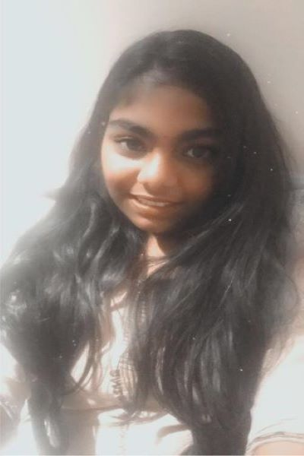
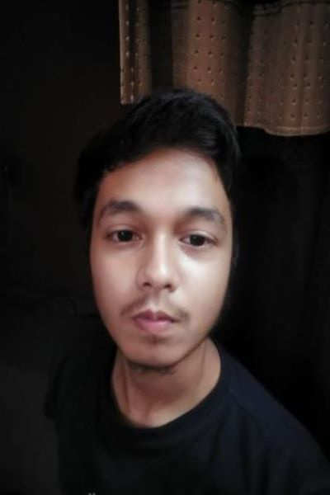

Meet Our Team!
THEME
CODE
PROJECT
TEAM
BENEFITS
Aditya Kumar
Mallika Evuri
Sohaibullah Najmi
Backend Developer
Frontend Developer
Database Manager

Slide 11
Thank
You!

